Slide 1

Android and Robotics
Make Stuff, Have Fun
Jay Dellinger
google.com/+JayDellinger
@DellingerTech
#AnDevCon

Slide 2
A Bit About Me
Jay Dellinger
B.S. Aerospace Engineering
Lockheed Martin Aeronautical Systems (3 years)
Dellinger Technologies LLC (15 years)
Manheim (14 years)
Notes:
Manheim is the world’s leading provider of vehicle remarketing services.
Over 110 locations worldwide in 16 countries, we handle nearly eight million vehicles annually.

Slide 3
Agenda
General Robotics
Android as robotic component
Solving problems with robots
Development of a prototype
Arduino
Raspberry Pi
Android
Wrap Up/Review

Slide 4
General Robotics
Robot
“a machine that can do the work of a person and that works automatically or is controlled by a computer.”
-Merriam-Webster

Slide 5
General Robotics
Android
“A mobile robot usually with a human form.”
-Merriam-Webster

Slide 6
Robots Among Us
You will find plenty of robots around you every day
Toys
Animatronics
Lego Mindstorms
Sphero
Home Automation
Climate Control
Roomba
Manufacturing
Assembly
Quality Control
Automotive
Vehicles
Traffic Signals
Military & Police
Bomb disposal
Drone aircraft
Others…

Slide 7
Robots In the News
Space probes and Planetary Exploration
Amazon Drone Delivery
FAA regulations ~2015
Google Driverless Vehicles
Google Robotics Acquisitions
8 robotics companies

Slide 8
Robots In Fiction
Star Wars
Transformers
Robocop
Wall-E
I, Robot
Terminator
Etc., Etc., Etc…
Ubiquitous in our entertainment which feeds general expectations…for better or worse.

Slide 9
Three Laws of Robotics
A robot may not injure a human being or, through inaction, allow a human being come to harm.
A robot must obey the orders given to it by human beings, except where such orders would conflict with the first law.
A robot must protect its own existence as long as such protection does not conflict with the first or second law.
- Isaac Asimov

Slide 10
Android as Robotics Platform
Embedded Android on custom boards
Standard Android device as an onboard controller
Standard Android device as a remote controller

Slide 11
Robotics vs Software Concepts
Integration of multiple systems
Specialization of components
Inputs/outputs
Model-View-Controller

Slide 12
Innovation Day
Problem: Large vehicle lots filled with cars
Goal: Timely information on vehicle location
Considerations
Hard wired sensor tracking (RFID)
Mobile scanning of RFID
Robotic approaches
Visual vs non-visual scanning
Autonomous vs manual control
Application of external interests as potential solution

Slide 13
Prototype Development
Problem: small vehicle controlled from my device with live video feed
Solution: Impossible! (let’s break this down a bit)
Components
Chassis with wheels and motors
Some way to control motors
Video stream
Android app as controller
This is a contrived example but serves to illustrate the process of developing prototype hardware.

Slide 14
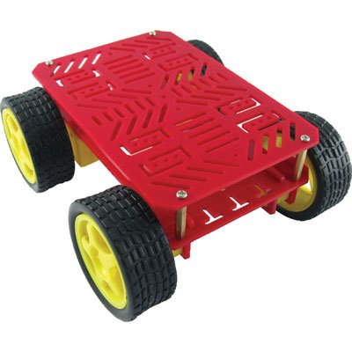
Rover Chassis
No specific requirements around speed or terrain
Simple 4wd frame with motors (~$25)
For prototyping, opt for two wheels plus a caster for easier use
Tank-style steering does not work well with low powered motors

Slide 15
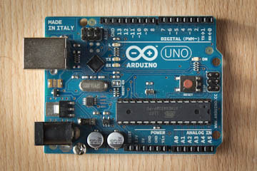
Controlling motors
Arduino vs Raspberry Pi vs Beaglebone Black
Decision factors
Experience with each platform
Arduino is easy to integrate with motors, connectivity via shields, video (not really)
Raspberry Pi has large community support, fewer GPIO pins, better multimedia, USB
Beaglebone Black has more pins for integration, more powerful than Raspberry Pi, smaller community support, USB
Microcontroller vs Microprocessor
Arduino (~$25), Raspberry Pi (~$40), Beaglebone Black (~$55)

Slide 16
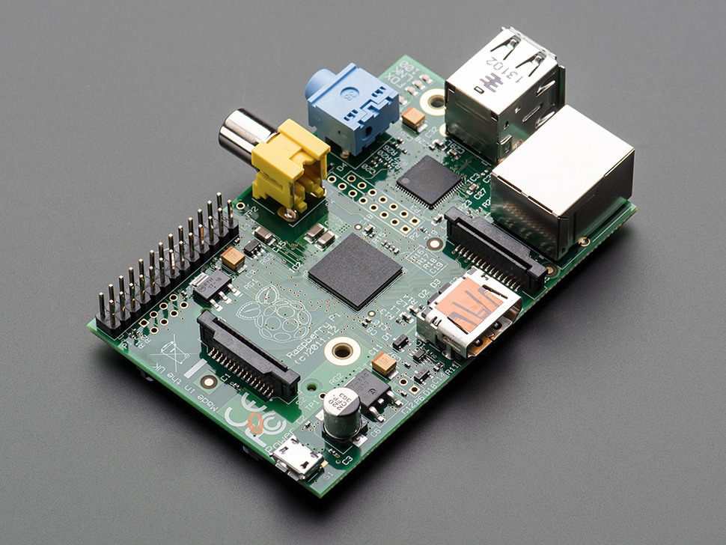
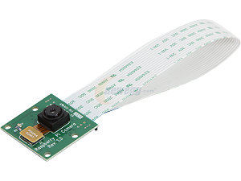
Providing video
Arduino not a good option
Raspberry Pi has a dedicated camera connection (Camera ~$30)
Beaglebone Black would use a USB webcam

Slide 17
Android Controller
Handle control input for rover
Display video stream
Connectivity
WiFi
Bluetooth

Slide 18
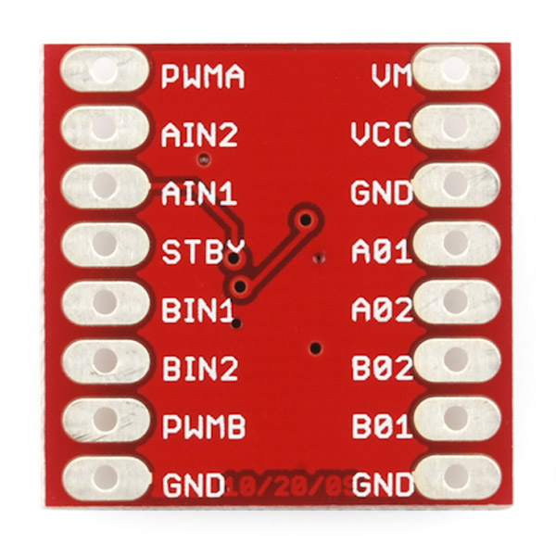
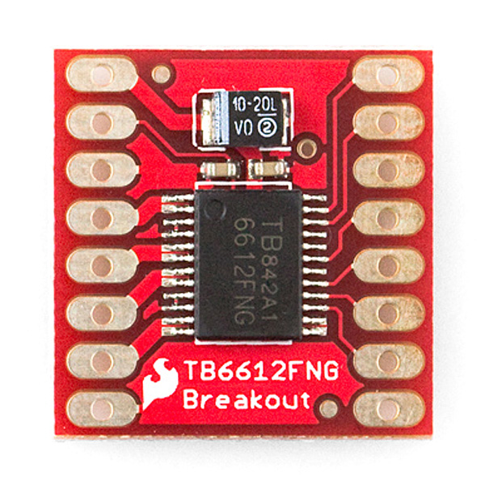
Let’s Get Started
Assemble chassis and motors
Wire motors to Arduino for testing using a breadboard
Limit the current through the pins
H-bridge for motor control
Sparkfun Motor Driver 1A Dual (~$9)

Slide 19
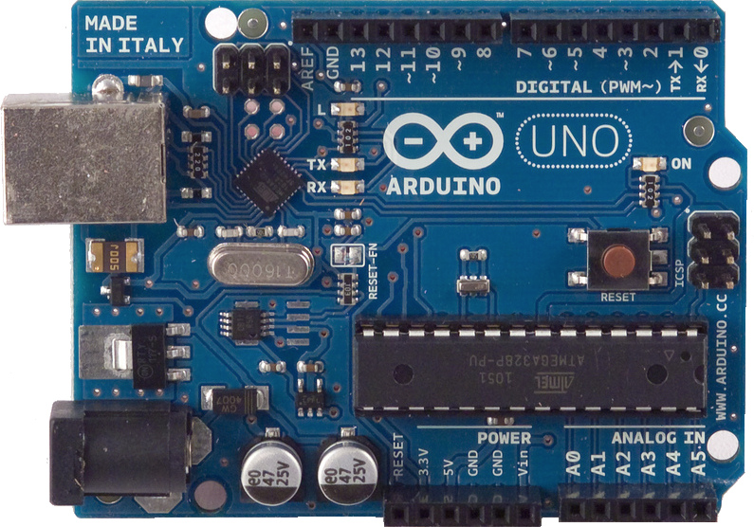
Arduino UNO

Slide 20

Programming Arduino
Arduino IDE
Set of C/C++ functions
setup()
loop()

Slide 21
Programming Arduino
const int STBY = 2;
const int AIN1 = 3;
const int AIN2 = 4;
const int PWMA = 5;
const int BIN1 = 6;
const int BIN2 = 7;
const int PWMB = 9;
const int MOTOR_LEFT = 1;
const int MOTOR_RIGHT = 2;
const int SPEED = 200;
const int fwdPin = 12;
const int backPin = 11;
Notes:
This meta data tag in AndroidManifest will indicate the version of Play Services that was used in compilation.

Slide 22
Programming Arduino
void setup(){
Serial.begin(9600);
//motor control
pinMode(STBY, OUTPUT);
pinMode(PWMA, OUTPUT);
pinMode(AIN1, OUTPUT);
pinMode(AIN2, OUTPUT);
pinMode(PWMB, OUTPUT);
pinMode(BIN1, OUTPUT);
pinMode(BIN2, OUTPUT);
//button inputs
pinMode(fwdPin, INPUT_PULLUP);
pinMode(backPin, INPUT_PULLUP);
}
Notes:
This meta data tag in AndroidManifest will indicate the version of Play Services that was used in compilation.

Slide 23
Programming Arduino
enum DriveState {
forward,
backward,
left,
right,
none
};
Notes:
This meta data tag in AndroidManifest will indicate the version of Play Services that was used in compilation.

Slide 24
Programming Arduino
void loop(){
DriveState state = getStateFromButtons();
switch(state){
case forward:
goForward(SPEED);
break;
case backward:
goBackward(SPEED);
break;
case left:
turnLeft(SPEED);
break;
case right:
turnRight(SPEED);
break;
default:
stopMotor();
}
}
Notes:
This meta data tag in AndroidManifest will indicate the version of Play Services that was used in compilation.

Slide 25
Programming Arduino
DriveState getStateFromButtons(){
int fwd = digitalRead(fwdPin);
int bwd = digitalRead(backPin);
DriveState state = none;
if(fwd == LOW && bwd == LOW){
state = left;
}else if(fwd == LOW){
state = forward;
}else if(bwd == LOW){
state = backward;
}else{
state = none;
}
return state;
}
Notes:
This meta data tag in AndroidManifest will indicate the version of Play Services that was used in compilation.

Slide 26
Programming Arduino
void goForward(int speed){
driveMotor(MOTOR_LEFT, speed, 1);
driveMotor(MOTOR_RIGHT, speed, 1);
Serial.println("forward");
}
void goBackward(int speed){
driveMotor(MOTOR_LEFT, speed, 0);
driveMotor(MOTOR_RIGHT, speed, 0);
Serial.println("backward");
}
Notes:
This meta data tag in AndroidManifest will indicate the version of Play Services that was used in compilation.

Slide 27
Programming Arduino
void driveMotor(int motor, int speed, int direction){
digitalWrite(STBY, HIGH);
boolean inPin1 = LOW;
boolean inPin2 = HIGH;
if(direction == 1){
inPin1 = HIGH;
inPin2 = LOW;
}
if(motor == MOTOR_LEFT){
digitalWrite(AIN1, inPin1);
digitalWrite(AIN2, inPin2);
analogWrite(PWMA, constrain(speed, 0, 255));
}else if(motor == MOTOR_RIGHT){
digitalWrite(BIN1, inPin1);
digitalWrite(BIN2, inPin2);
analogWrite(PWMB, constrain(speed, 0, 255));
}
}
Notes:
This meta data tag in AndroidManifest will indicate the version of Play Services that was used in compilation.

Slide 28
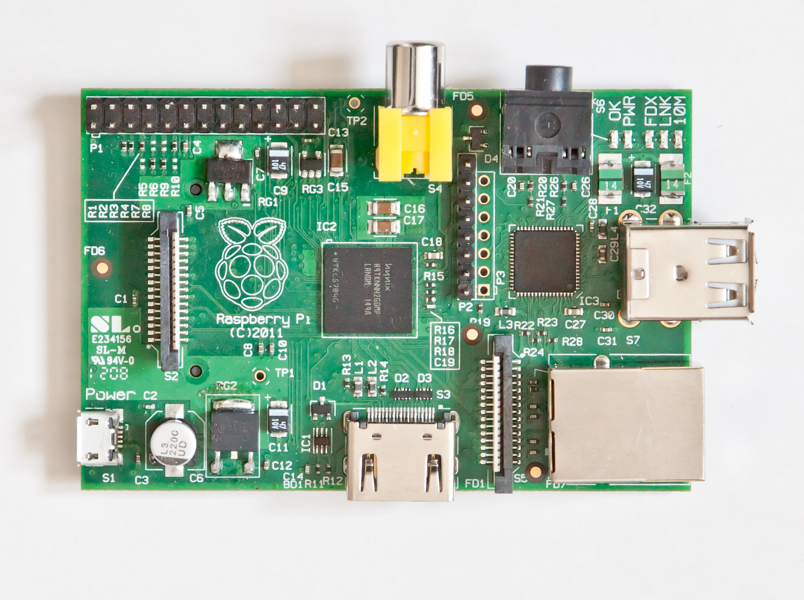
Raspberry Pi

Slide 29

Raspberry Pi
Raspbian
Python code with GPIO library
Web.py library to provide basic http endpoints
Use 3 pins to signal movement request
001 – forward
010 – backward
011 – left
100 – right
Additional pin for status

Slide 30
Programming Raspberry Pi
import RPi.GPIO as GPIO
def init():
GPIO.setmode(GPIO.BCM)
GPIO.setup(18, GPIO.OUT)
GPIO.setup(23, GPIO.OUT)
GPIO.setup(24, GPIO.OUT)
GPIO.setup(25, GPIO.OUT)
GPIO.output(18, True)
def forward():
GPIO.output(23, True)
GPIO.output(24, False)
GPIO.output(25, False)
def backward():
GPIO.output(23, False)
GPIO.output(24, True)
GPIO.output(25, False)
rover.py
Notes:
This meta data tag in AndroidManifest will indicate the version of Play Services that was used in compilation.

Slide 31
Programming Raspberry Pi
def left():
GPIO.output(23, True)
GPIO.output(24, True)
GPIO.output(25, False)
def right():
GPIO.output(23, False)
GPIO.output(24, False)
GPIO.output(25, True)
def stop():
GPIO.output(23, False)
GPIO.output(24, False)
GPIO.output(25, False)
def cleanup():
GPIO.output(18, False)
GPIO.cleanup()
rover.py
Notes:
This meta data tag in AndroidManifest will indicate the version of Play Services that was used in compilation.

Slide 32
Programming Raspberry Pi
import atexit, threading, time, web
from rover import *
timer = None
state = 'stop'
urls = (
'/(.*)', 'servicehandler'
)
app = web.application(urls, globals())
def cleanup_rover():
cleanup()
if __name__ == "__main__":
atexit.register(cleanup_rover)
init()
app.run()
rover_service.py
Notes:
This meta data tag in AndroidManifest will indicate the version of Play Services that was used in compilation.

Slide 33
Programming Raspberry Pi
class servicehandler:
def GET(self, action):
global state
reset_safety()
if not action:
action = 'status'
if action == 'forward':
forward()
state = action
elif action == 'backward':
backward()
state = action
elif action == 'left':
left()
state = action
elif action == 'right':
right()
state = action
elif action == 'stop':
safety_stop()
return state
rover_service.py
Notes:
This meta data tag in AndroidManifest will indicate the version of Play Services that was used in compilation.

Slide 34
Programming Raspberry Pi
def reset_safety():
global timer
if timer:
timer.cancel()
timer = threading.Timer(5, safety_stop)
timer.start()
def safety_stop():
global state
stop()
state = 'stop'
timer.cancel()
rover_service.py
Notes:
This meta data tag in AndroidManifest will indicate the version of Play Services that was used in compilation.

Slide 35
Updating Arduino
const int ledPin = 13;
const int pi0 = A0;
const int pi1 = A1;
const int pi2 = A2;
const int pi3 = A3;
//..in setup()..//
pinMode(ledPin, OUTPUT);
//raspberry pi comms
pinMode(pi0, INPUT);
pinMode(pi1, INPUT);
pinMode(pi2, INPUT);
pinMode(pi3, INPUT);
//..in loop ()..//
DriveState state = getStateFromButtons();
if(state == none){
state = getStateFromPi();
}
Notes:
This meta data tag in AndroidManifest will indicate the version of Play Services that was used in compilation.

Slide 36
Updating Arduino
DriveState getStateFromPi(){
int p0 = digitalRead(pi0);
int p1 = digitalRead(pi1);
int p2 = digitalRead(pi2);
int p3 = digitalRead(pi3);
if(p3 == HIGH){
digitalWrite(ledPin, HIGH);
if(p0 == HIGH && p1 == LOW && p2 == LOW){
return forward;
}else if(p0 == LOW && p1 == HIGH && p2 == LOW){
return backward;
}else if(p0 == HIGH && p1 == HIGH && p2 == LOW){
return left;
}else if(p0 == LOW && p1 == LOW && p2 == HIGH){
return right;
}else{
return none;
}
}else{
digitalWrite(ledPin, LOW);
}
}
Notes:
This meta data tag in AndroidManifest will indicate the version of Play Services that was used in compilation.

Slide 37
Raspberry Pi WiFi
Run as an Access Point to avoid dynamic configuration
DHCP server on board
Static IP address
Issues with drivers and configuration
Patched version of hostapd with Edimax WiFi dongle
http://goo.gl/HuamqV

Slide 38
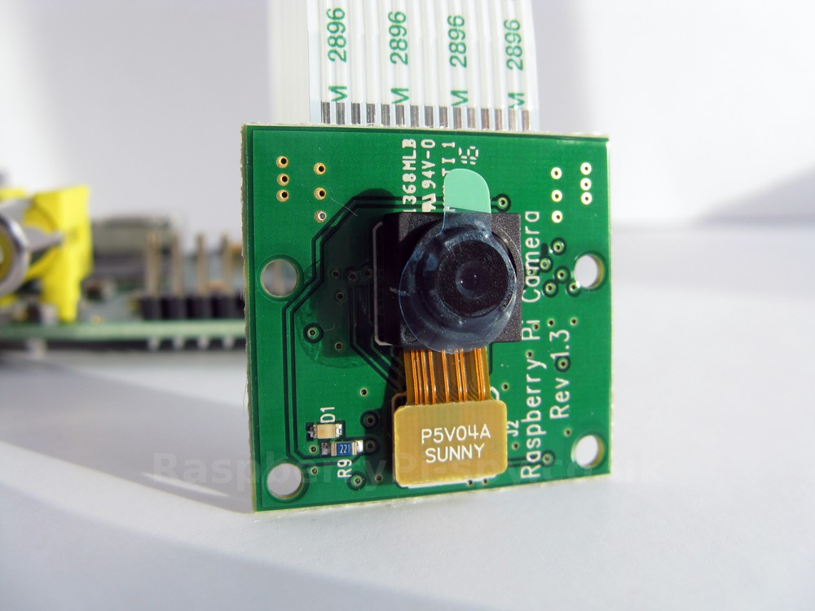
Raspberry Pi Camera
raspistill and raspivid
mjpg_streamer
http://goo.gl/52T8nm
mkdir /tmp/stream
raspistill --nopreview -w 640 -h 480 -q 5 -o /tmp/stream/pic.jpg -tl 100 -t 9999999 -th 0:0:0 &
LD_LIBRARY_PATH=/usr/local/lib /usr/local/bin/mjpg_streamer -i "input_file.so -f /tmp/stream -n pic.jpg" -o "output_http.so -w /usr/local/www -p 8081" &

Slide 39
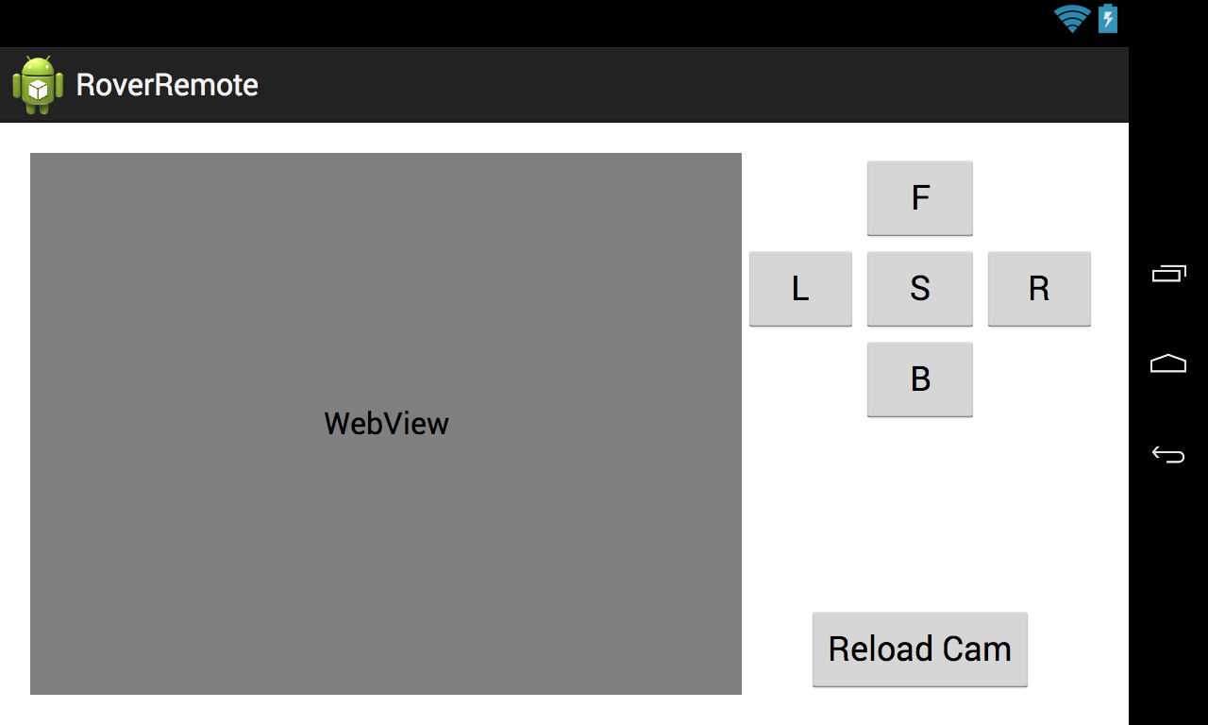
Android Controller
Basic UI with buttons and webview
Add click handlers for movements
Add way to repeatedly send state

Slide 40
RoverManager.java
private long lastUpdate;
private String lastCommand;
State currentState = State.Stop;
public enum State {
Forward("forward"),
Backward("backward"),
Left("left"),
Right("right"),
Stop("stop");
private String action;
private State(String action){
this.action = action;
}
public String getAction(){
return action;
}
}
Public State getState(){
return currentState;
}
Notes:
This meta data tag in AndroidManifest will indicate the version of Play Services that was used in compilation.

Slide 41
RoverManager.java
public void forward(){
currentState = State.Forward;
}
public void backward(){
currentState = State.Backward;
}
public void left(){
currentState = State.Left;
}
public void right(){
currentState = State.Right;
}
public void stop(){
currentState = State.Stop;
}
private String buildUrl() {
return String.format("http://192.168.3.1:8080/%s", currentState.getAction());
}
Notes:
This meta data tag in AndroidManifest will indicate the version of Play Services that was used in compilation.

Slide 42
RoverManager.java
public void sendUpdate(){
//call service on RPi
try {
String command = buildUrl();
long now = System.currentTimeMillis();
if(command != null && (!command.equals(lastCommand) || now - lastUpdate > 4000)){
Log.i(MainActivity.TAG, "Sending update: "+command);
HttpClient httpclient = new DefaultHttpClient();
HttpResponse response = httpclient.execute(new HttpGet(buildUrl()));
StatusLine statusLine = response.getStatusLine();
if (statusLine.getStatusCode() == HttpStatus.SC_OK) {
//..more logic
lastUpdate = System.currentTimeMillis();
lastCommand = command;
} else {
response.getEntity().getContent().close();
}
}
}catch(Exception e){
Log.e(MainActivity.TAG, "exception sending update", e);
}
}
Notes:
This meta data tag in AndroidManifest will indicate the version of Play Services that was used in compilation.

Slide 43
MainActivity.java
Handler handler = new Handler();
Runnable updater = new Runnable() {
@Override
public void run() {
AsyncTask updaterTask = new AsyncTask() {
@Override
protected Object doInBackground(Object[] objects) {
roverManager.sendUpdate();
return null;
}
@Override
protected void onPostExecute(Object o) {
super.onPostExecute(o);
if(active) {
handler.postDelayed(updater, 20);
}
}
};
updaterTask.execute();
}
};
Notes:
This meta data tag in AndroidManifest will indicate the version of Play Services that was used in compilation.

Slide 44
MainActivity.java
@Override
protected void onResume() {
super.onResume();
webView.loadUrl("http://192.168.3.1:8081/stream_simple.html");
active = true;
handler.post(updater);
}
@Override
protected void onPause() {
super.onPause();
active = false;
}
Notes:
This meta data tag in AndroidManifest will indicate the version of Play Services that was used in compilation.

Slide 45
Prototype State and Future
Functions as desired (mostly)
Multi-client access is broken
Power sources are a bit over the top
Chassis maneuverability is disappointing
Consider Beaglebone Black for more processing power and consolidation of components
Polish UI; Add sensor inputs from Android device? (Accel, BT joystick)
On board sensors for autonomous logic. (sonar, light sensor, etc)
Miniaturization with smaller microcontrollers; custom circuit boards.

Slide 46
Wrap Up
Robotics can be a fun and exciting outlet for trying new ideas.
The same processes and concepts you use for software development really kind of apply to hardware also.
Break problems into smaller, more manageable tasks
Define reusable interfaces, decouple functionality, componentize
We worked through a sample prototype with less than a couple hundred dollars in materials.
Whatever your interests, keep your eyes open for opportunities to take advantage of them.
Buy some hardware, hack it together, see what happens.

Slide 47
Thanks!
Questions?
http://www.arduino.cc
http://www.raspberrypi.org
http://www.beagleboard.org
http://webpy.org
LM2596 Switching Regulator (eBay)
http://www.sparkfun.com
http://www.adafruit.com
Jay Dellinger
google.com/+JayDellinger
@DellingerTech
github.com/jdellinger

